Slide 1
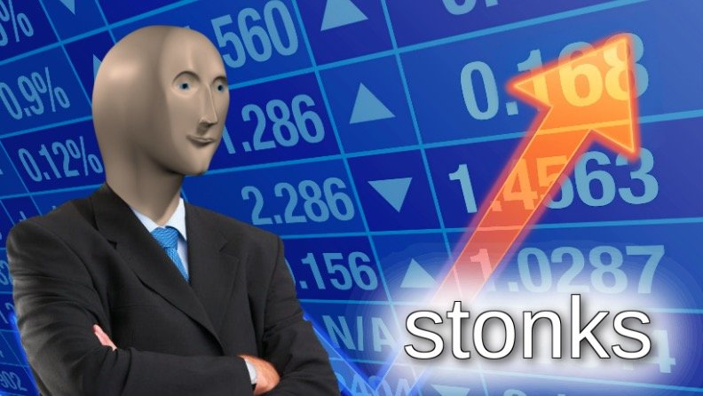
Finance 101

Slide 2
Credit Cards Perks and Features
Cash Back
Sign on Bonus (100-300)
Rental Car Collision Waiver (visa cards have this)
No international fees
Many other random perks (especially travel cards)

Slide 3

How many credit cards?
Baseline: everyone should get a 2% back card
If you spend 20,000 a year that's $400 cash back. Keep in mind some places charges a fee to use credit card. So the fact that we can pay rent with credit cards at no fee is rare.
But beyond this you’re just looking at percentage difference, if you spend 7,000 a year on food, a 3% food card will net you an additional $70
Ofc there are 5% cards like amazon which might be more worth it if you spend a lot of money there (totally not me)

Slide 4
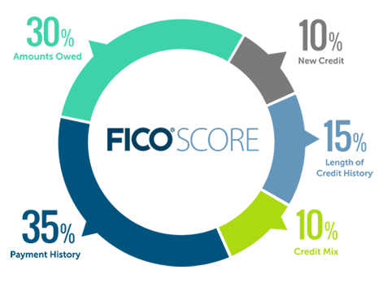
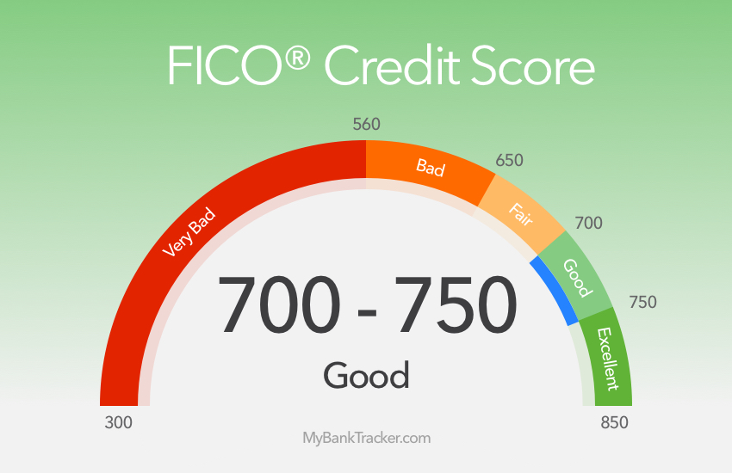
Credit Score
It matters for renting places, securing rates, opening credit cards, other random stuff
Utilization Rate: Aim for 30%, if you’re over just pay it down before statement is due*

Slide 5
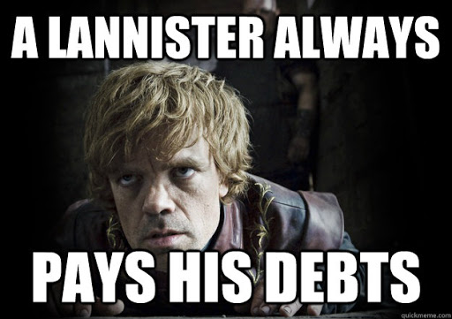
Always Pay Statement Balance
For comparison Venezuela's lending rate is 23.8%
You get 7% annualized return in Stonks
So please don’t pay 25% interest rate on CC
Just set it on Auto Pay and forget about it

Slide 6
Checking Accounts
Unlimited withdrawals, much lower interest rate
FDIC insured
Features to look for:
ATM fee rebate
Interest rate (see sofi’s if you’re American, AKA everyone except for me)
Signing bonus : )
No minimum balance/monthly fees

Slide 7
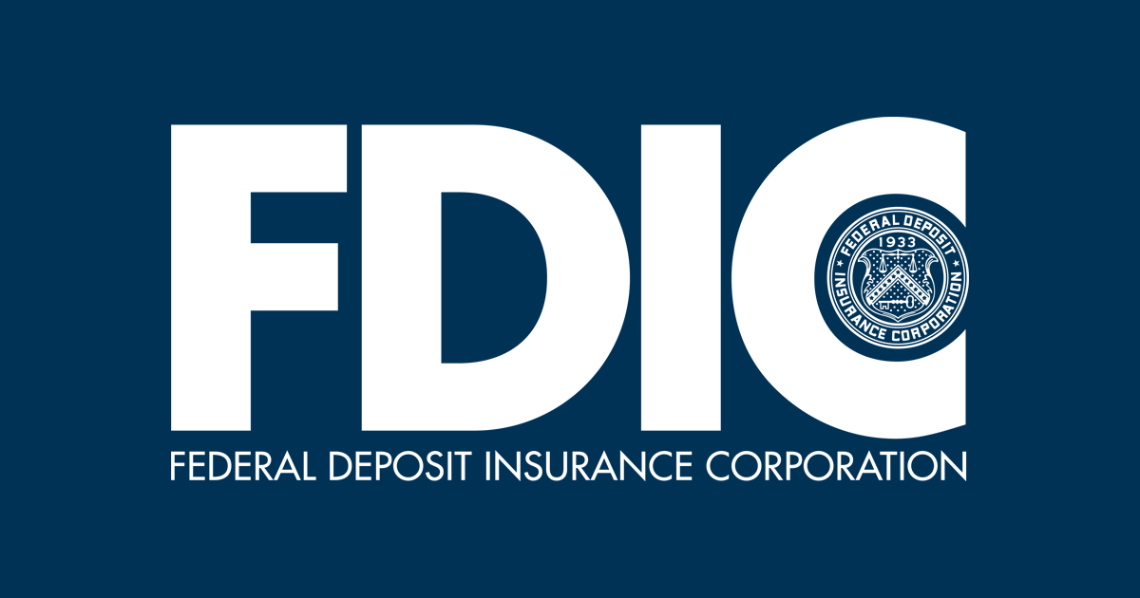
Savings Account
Higher Interest Rates (usually you can find at least 1% higher)
If you have 20,000 in savings that's an extra 200 dollars
Limited to 6 withdrawals before fees (federally mandated)
FDIC insured

Slide 8
My personal set up
Savings Account (high interest)
Checking Account (low interest)
Other random stuff like venmo, tuition, cash
Credit Card (negative interest : (
Credit Card (negative interest : (
Credit Card (negative interest : (
Credit Card (negative interest : (

Slide 9
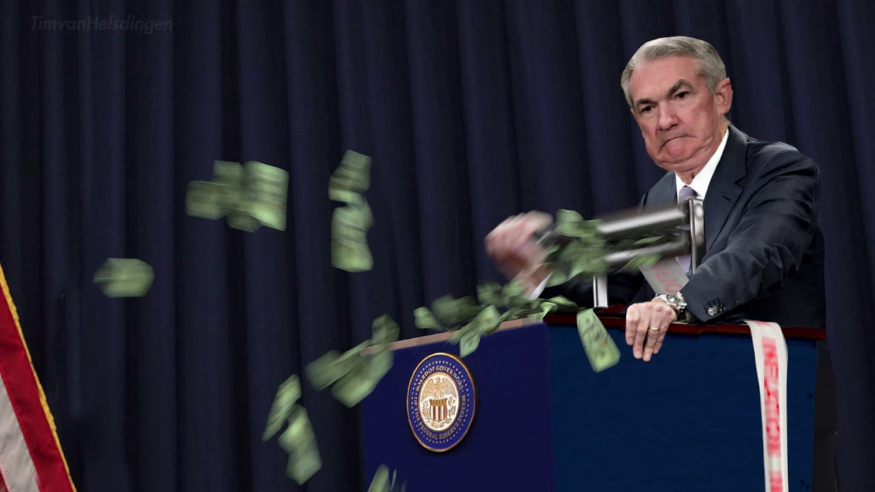
APY vs APR
APY: Annual Percent Yield, how much % you’ll get back in a year
APR: Annual Percent Rate: Simple interest

Slide 10
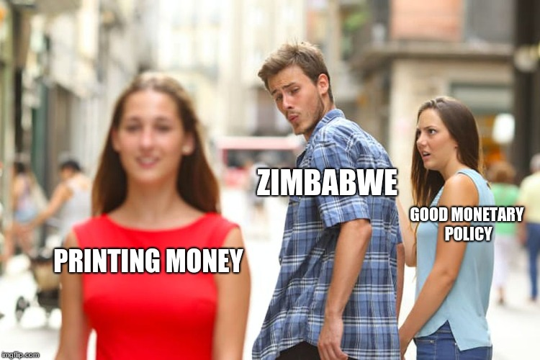

Slide 11
Bonds
Units of corporate/government debt
US treasury used to peg the risk free rate
Boring low risk (for US gov debt)
There is corporate debt, but in general, the better the pay-off the higher the risk of default
My personal thoughts on bonds is that it’s good for diversifying and lowering risk, but we are young with nothing to lose so yolo.
Also since I’m putting this ppt up on my website, THIS PRESENTATION IS FOR MY FRIENDS WHERE I TALK MORE, SO THE BULLET POINTS DON’T CAPTURE EVERYTHING I SAY, DON’T TAKE INVESTMENT ADVICE FROM ME, I’M JUST SOME KID WHO KNOWS NOTHING.:)

Slide 12

Stonks
A certain percentage ownership of the company
You’re paid last in cases of bankruptcy

Slide 13
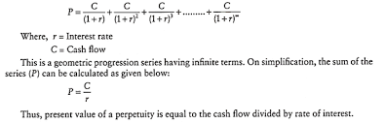
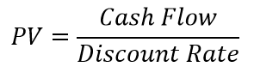
Oversimplified Valuation
Expected return on investment subjected to a discount rate
How you can think of it:
Perpetuity: Assume inflation growth rate after some fixed time of > than inflation growth rate. So basically just the sum of a converging geometric series.
Company Apple makes a profit of 57 billion dollars every year, assuming no growth and a discount rate of 3%, what is the fair market value?
Sell off: Make some profit for x amount of years, firm is sold for x cost.

Slide 14
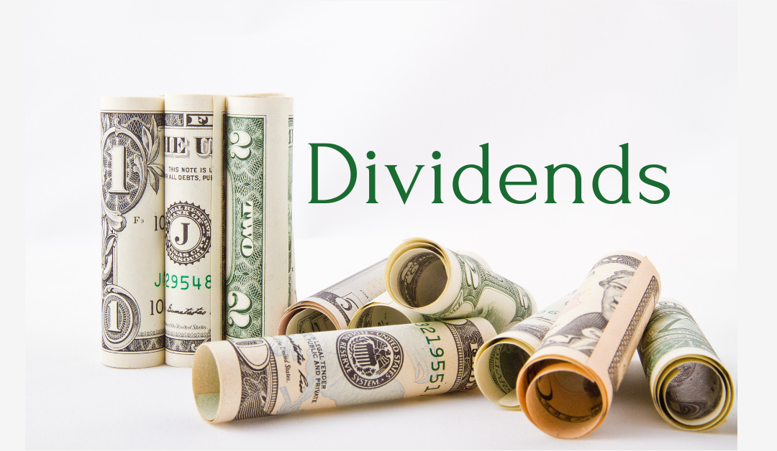
Do dividends matter?
In theory no

Slide 15
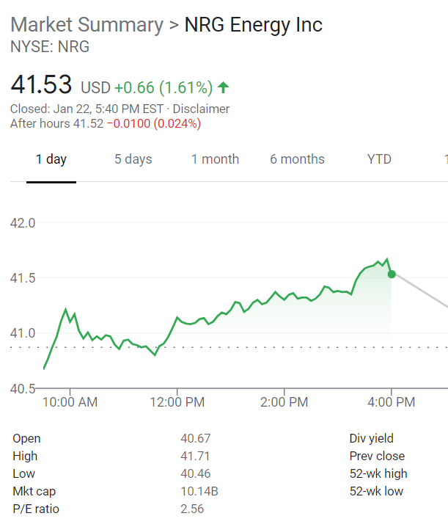
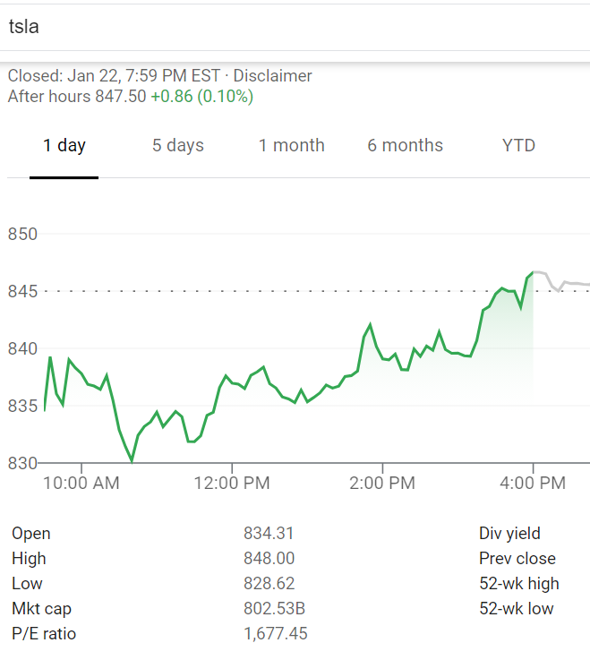
Useful Metric: P/E
The P/E ratio is calculated by dividing the market value price per share by the company's earnings per share.

Slide 16
Shorting Stonks
Borrow a stonk you don’t have and sell it, buy it again some time later (cover) and return the stonk
You can think of it like this (this is not how it actually works): Theo has a bike in the basement that he never actually uses, Jananni thinks that this bike is going to cost a lot less to buy from Walmart in the future for whatever reason. Jananni puts this bike on for sale and takes all the money from the sale. Later when the price of the bike is a lot cheaper at walmart, Jananni buys the bike from Walmart (covering) and puts it back into the basement, Theo is non the wiser. Ofcourse, if the price of this bike actually goes up Jananni loses money. And in theory, the price of the bike could go up to infinity so Jananni’s downside on doing this is in theory infinite.
Since stonks pay dividends, Jananni is in charge of paying Theo dividends while she has not covered the position.

Slide 17
dy/dx Stonks (derivatives (options))
Strike Price: the price at which a put or call option can be exercised.
Expiry Date: Last date contract is valid
Put Options
Ability but not obligation to sell stonks at strike price by expiration date
Call Options
Ability but not obligation to buy stonk at strike price

Slide 18
Last instant valuation of options
If Warren Buffet buys 1 contract of GME call options with a strike price of 52 bucks for $50, and GME is currently trading at $65 how much is this contract worth if it expires in the next instant?
If Citron buys 1 contract of TSLA put options with a strike price of 100 bucks for $200, and TSLA is currently trading at $800 how much is this contract worth if it expires in the next instant?

Slide 19
Naked
Naked positions just refer to not holding the underlying asset
Could be risky, some brokerage like RobinHood won’t let you hold naked positions*
*Only if the naked position opens you up to lose more money than just what you paid/sold for the contract.

Slide 20
Quiz Time

Slide 21
Stonks only go up?

Slide 22


Slide 23
Number of free transactions allowed on a savings account

Slide 24
6

Slide 25
What does it mean to be FDIC insured? How much does it insure up to?

Slide 26
250,000/account
(if you don’t you are not hitting your FDIC limit, you don’t have to worry about Biden’s tax plan)

Slide 27
Would you prefer 2% APY or APR?
Assuming you compound interest at a rate higher than once a year.

Slide 28
APR
APY

